Slide 1


Bruno Loubière
30-Oct-2023

Slide 2

Outline
Executive Summary
Introduction
Methodology
Results
Conclusion
Appendix

Slide 3
Executive Summary
Aim: Identification of factors for successful rocket launching by Space X agency
Summary of Methodologies
Collect from SpaceX REST API
Wrangle to create variables
Explore with data visualization
Analyse with SQL queries
Geographical visualization of launch sites
Model building to predict landing outcomes
Summary of results
Exploratory analysis
KSC LC-39A launch site has the highest rate of success
Orbits ES-L1, GEO, HEO, SSO have 100% rate
Visualisation
Launch sites in US are in Southern part and near coasts
Predictive
All models performed comparably

Slide 4
Introduction
Project background
Space X is leading the space industry by providing cheaper rocket (~$62 million) compared to its concurrents (~$165 millions each). This is possible due to its reuse of the first stage of its Falcon 9 rocket.
By determining the probability of a successful landing for the first stage, a price can for example be determined accordingly.
Aim
Explore how payload mass, launch site, number of flights and orbits affect success
Determine rate of success over time
Build a predictive model for successful landing

Slide 5

Section 1

Slide 6
Methodology
Executive Summary
Data collection methodology:
Collection using SpaceX REST API and scrapping techniques
Perform data wrangling
Filtering and cleaning of the data, one-hot encoding for next step
Perform exploratory data analysis (EDA) using visualization and SQL
Perform interactive visual analytics using Folium and Plotly Dash
Perform predictive analysis using classification models
Evaluation of models to identify best parameters and fit

Slide 7
Data Collection – SpaceX API
Steps
Request data from API url
Decode json file
Convert json to Pandas dataframe
Use API to complete rocket information using custom functions
Filter Falcon 9 rockets only
Data cleaning replace missing Payload Mass values with its mean
Export data to .csv file
Notebook url: https://github.com/bncloubiere/IBM_Data_Science_final_project/blob/main/Part01_SPACEX_Data_collection_API.ipynb
API request
Json decode
Dataframe creation
Info request API
Data filtering
Export to csv
Data cleaning

Slide 8
Data Collection - Scraping
Steps
Request data from Wikipedia
Create BeautifulSoup object for parsing
Extract column names from HTML
Collect data by parsing tables
Create dictionary
Convert dictionary to datframe
Export data to .csv file
Notebook url:https://github.com/bncloubiere/IBM_Data_Science_final_project/blob/main/Part02_SPACEX_WEB_scraping.ipynb
Request Data (Wikipedia)
BeautifulSoup object
Column names extraction
Insert info in dictionary
Export to csv
Convert dictionary to dataframe
Web parsing for content

Slide 9
Data Wrangling
Aim: perform EDA to determine outcomes data labels
Create outcomes labels
Export to csv
Calculate number of outcomes for each orbit type
Calculation: launches
Number launches per sites
Number launches per orbit types
Number of outcomes per prbit types
Outcomes converted to binary values:
- 1 for successful outcomes
- 0 for unsuccesful
CSV for next part
Gihub: https://github.com/bncloubiere/IBM_Data_Science_final_project/blob/main/Part03_SPACEX_Data_wrangling.ipynb

Slide 10
EDA with Data Visualization
Plotted charts
Fligth Number vs Payload Mass
Flight Number vs Launch Site
Payload Mass vs Launch Site
Flight Number vs Orbit type
Outcome vs Orbit type
Payload vs Orbit type
Success rate over time
Aim
Scatter plots showed relationship between variables (if exists) and if they could be used for building a model
Bar plots compared discreet categories
Line charts showed continuous trend over time
Gihub: https://github.com/bncloubiere/IBM_Data_Science_final_project/blob/main/Part05_SPACEX_Data_visualisation.ipynb

Slide 11
EDA with SQL
Display queries
Name of unique launch sites
5 records where launch site begins with “CCA”
Total payload mass carried by boosters launched by NASA
Average payload mass carried by bosster F9 v1.1
Listing queries
Date of first successful landing in ground pad
Names of boosters with success in drone ship and payload between 4000-6000 kg
Total number of fail/success outcomes
Names of boosters wich carried the maximum load
Failed outcomes in drone ship; with their booster version, and launch site, for the year 2015
Ranking of counts of landing outcomes between Jun-2010 and 20-Mar-2017
Gihub: https://github.com/bncloubiere/IBM_Data_Science_final_project/blob/main/Part04_SPACEX_EDA_sql.ipynb

Slide 12
Build an Interactive Map with Folium
Markers of all launch sites: - Added Markers with Circle, Popup Label, and Text Label of Nasa Johnson Space Center and of all the launch sites using latitudes and longitudes to show geographical locations
Coloured Markers of the launch outcomes for each launch site: - Added markers in green or red to show respectively successful or failed outcomes at each sites. Allows the identification of sites with high success rates
Distance between launch sites and points of interest: - Added coloured lines to show proximity with railway, coast line, highway and closest city
Gihub: https://github.com/bncloubiere/IBM_Data_Science_final_project/blob/main/Part06_SPACEX_Data_visualisation_folium.ipynb

Slide 13
Build a Dashboard with Plotly Dash
Added launch sites dropdown - Enables sites selection
Pie chart with proportion if successful launch per site - Enables the identification of sites with the highest amount of successful launches
Slider of Payload Mass range - To select a range of interest for visualization
Scatter plot of Payload vs Launch outcome - To visualise the correlation between Payload and Launch Success
Gihub: https://github.com/bncloubiere/IBM_Data_Science_final_project/blob/main/Part07_SPACEX_Data_analysis_plotly.py

Slide 14
Predictive Analysis (Classification)
Create NumPy array from Class column
Standardise with StandarScaller, fit and transform data
Split data with train_test_split
Create GridSearchCV (cv=10)
Apply GridSearchCV object in logistic regression, SVC, Decision tree, KNN
Identify best model (Jaccard scores, F1, accuracy)
Calculate accuracy
Assess confusion matrix
Gihub: https://github.com/bncloubiere/IBM_Data_Science_final_project/blob/main/Part08_SPACEX_Predictive_analysis.ipynb

Slide 15

Section 2

Slide 16
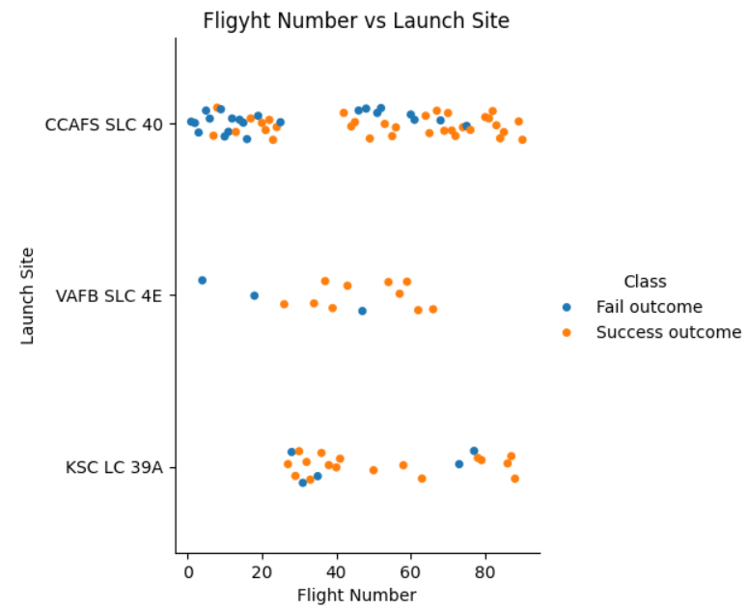
Flight Number vs. Launch Site
Earliest flights failed more than latest launches
Most of the launches were from CCAFS SLC 40
VAFB SLC 4E and KSC LC 39A have mostly succesful launches

Slide 17
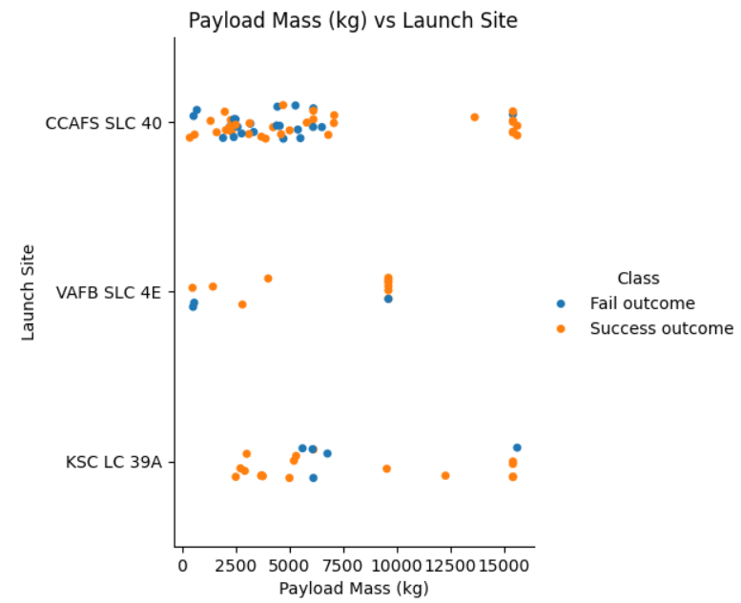
Payload vs. Launch Site
For every launch site: the higher the payload the most likely the outcome is a success
Most launches with a payload higher than 7,000 kg were successful

Slide 18
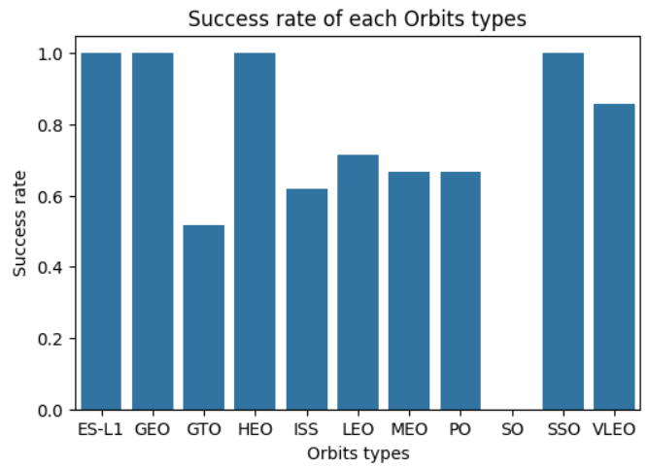
Success Rate vs. Orbit Type
Orbit with a 100% rate: ES-L1, GEO, HEO, SSO
Orbits with 0% success rate: SO
Orbits with success rate between 50 and 90%: GTO, ISS, LEO, MEO, PO

Slide 19
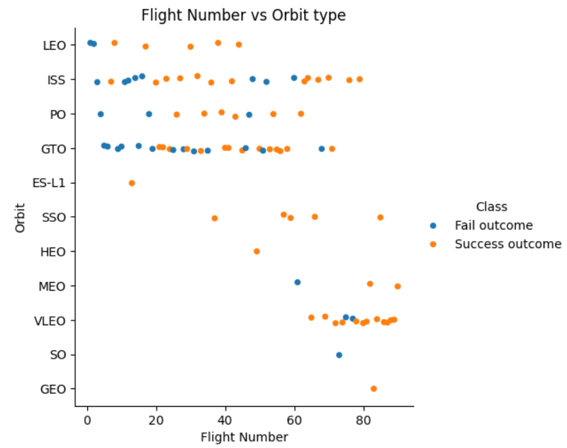
Flight Number vs. Orbit Type
In LEO orbits, success rates appears related to the number of flights
Other orbits type do not show any strong correlations

Slide 20
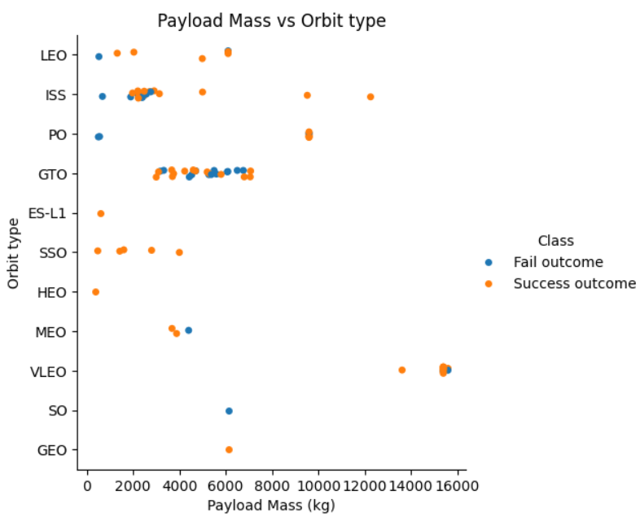
Payload vs. Orbit Type
Heavy payloads, the rate of successful landing are higher with orbits Polar, LEO and ISS
There is not correlation for GTO

Slide 21
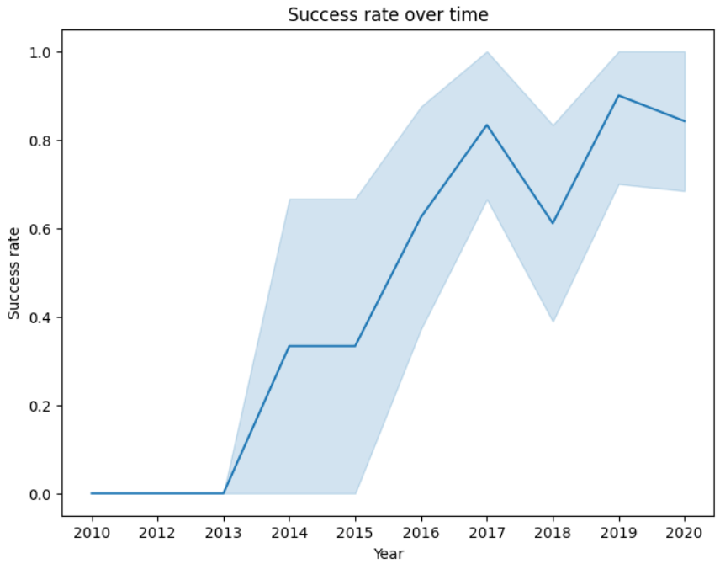
Launch Success Yearly Trend
Success rate kept increasing between 2013 and 2020

Slide 22
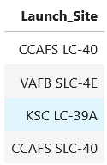
All Launch Site Names
Rockets were launched from only four unique sites CCAFS LC-40, VAFB SLC-4E, KSL LC-39A, CCAFS SLC-40

Slide 23
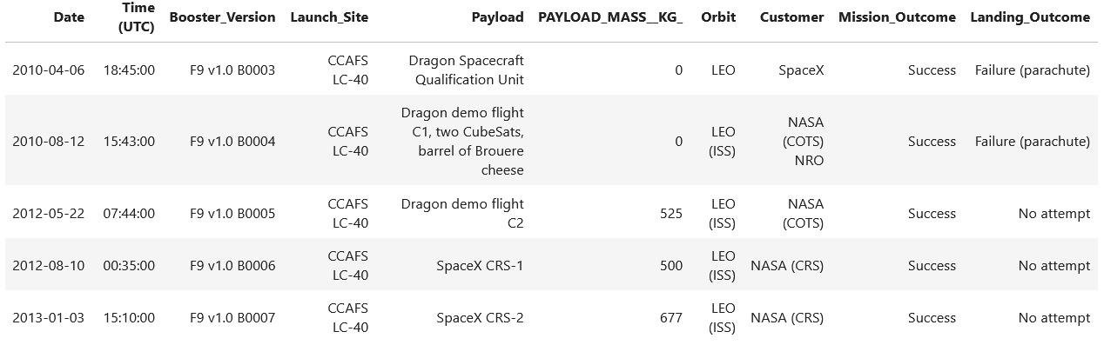
Launch Site Names Begin with 'CCA'
Example of 5 records where launch sites begin with `CCA`
Rockets are launched by Space X and NASA

Slide 24
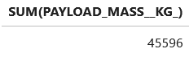
Total Payload Mass
NASA has sent a total of 45,596 kg of payload in space

Slide 25
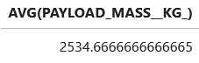
Average Payload Mass by F9 v1.1
The average payload mass carried by booster version F9 v1.1 is around 2,535 kg

Slide 26
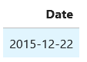
First Successful Ground Landing Date
The date of the first successful landing outcome on ground pad was December 22nd 2015

Slide 27
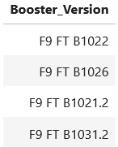
Successful Drone Ship Landing with Payload between 4000 and 6000
List the names of boosters which have successfully landed on drone ship and had payload mass greater than 4000 but less than 6000

Slide 28
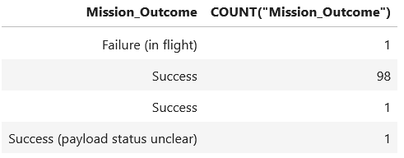
Total Number of Successful and Failure Mission Outcomes
Total number of successful and failure mission outcomes
There was 99 successes, 1 failure , and 1 success with payload status unclear

Slide 29
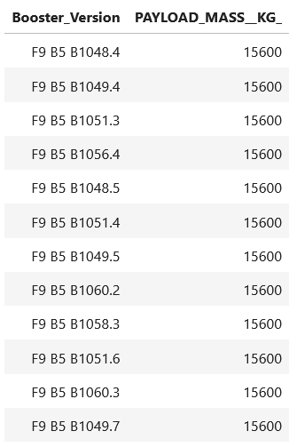
Boosters Carried Maximum Payload
List of the names of the booster which have carried the maximum payload mass of 15,600 kg

Slide 30
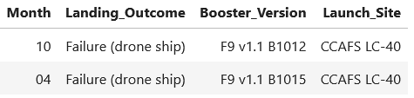
2015 Launch Records
List of the failed landing outcomes in drone ship, their booster versions, and launch site names for in year 2015
There were two failures in 2015. One was in April and one was in December

Slide 31
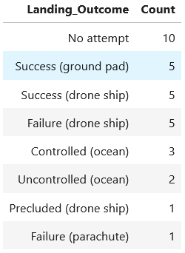
Rank Landing Outcomes Between 2010-06-04 and 2017-03-20
Ranked count of landing outcomes (such as Failure (drone ship) or Success (ground pad)) between the date 2010-06-04 and 2017-03-20, in descending order

Slide 32

Section 3

Slide 33
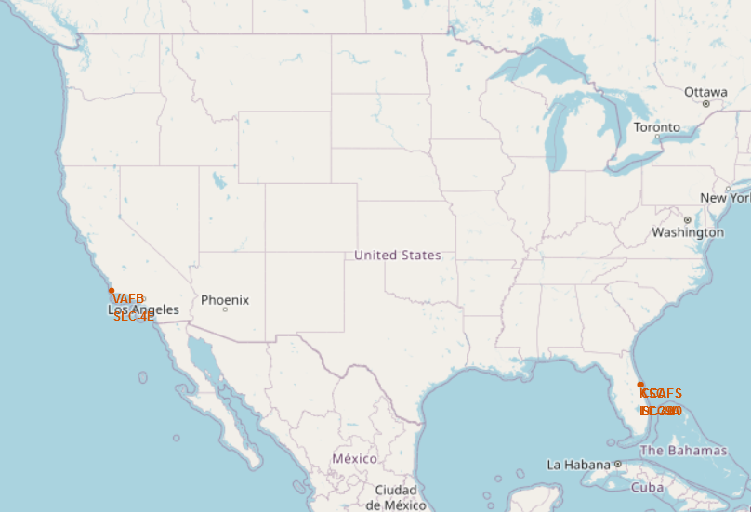
Location of launching sites on map
All the launching sites were in the Southern part of the US. Those represents places the closest to the equator line while still being on American soil
All the sites are locates near coast lines to minimize risk to civil population

Slide 34
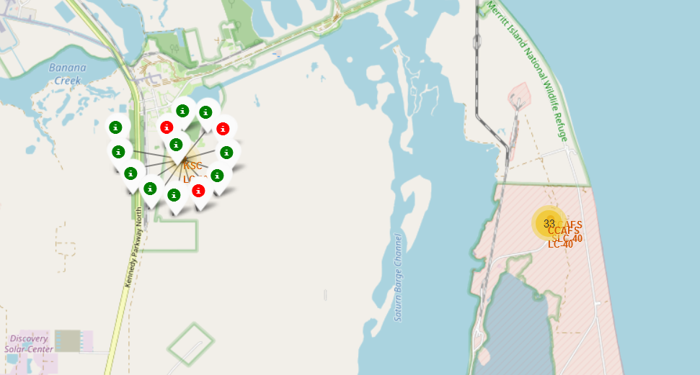
Colour-labeled launch outcome on map
The colour of the added labels allow the direct identification of the sites with high success rates
Launch site KSC LC-39A has a high success rate (green markers)

Slide 35
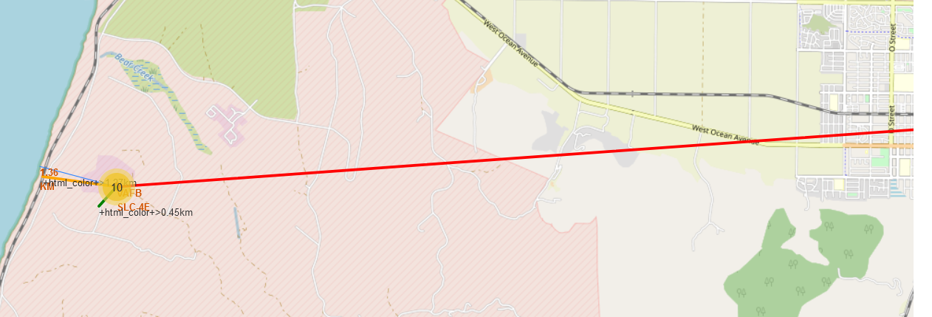
Distance of launch sites to points of interest
Launching sites are located: - close of rails (1.27 km), road (0.45 km) for easy transportation of rocket parts - close to coast (1.36 km) for safe areas for debris and failed rockets - far from city (14 km) for the safety of civil population

Slide 36

Section 4

Slide 37
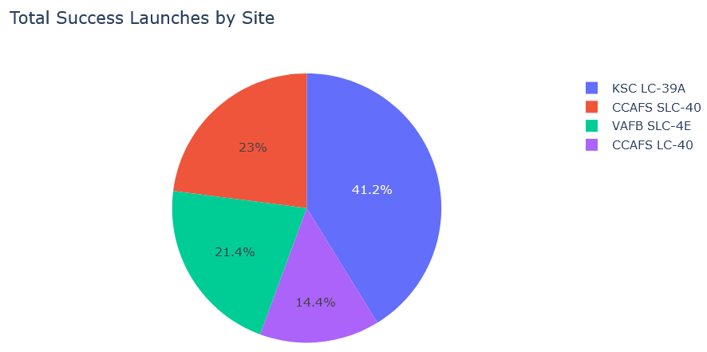
Proportion of success counts per launch sites
The site with the most success launches is KSC LC-39A

Slide 38
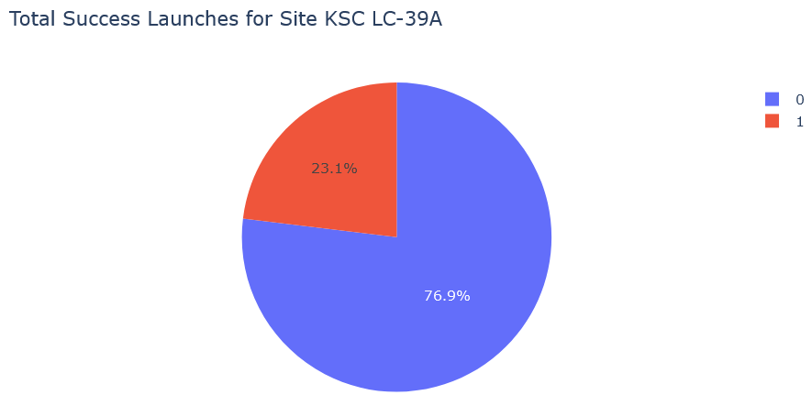
Site with highest success rate
The site with the highest rate of success is KSC LC-39A with a rate of 76.9%

Slide 39
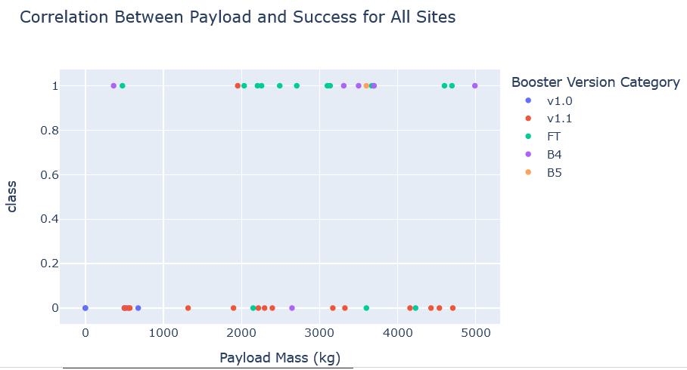
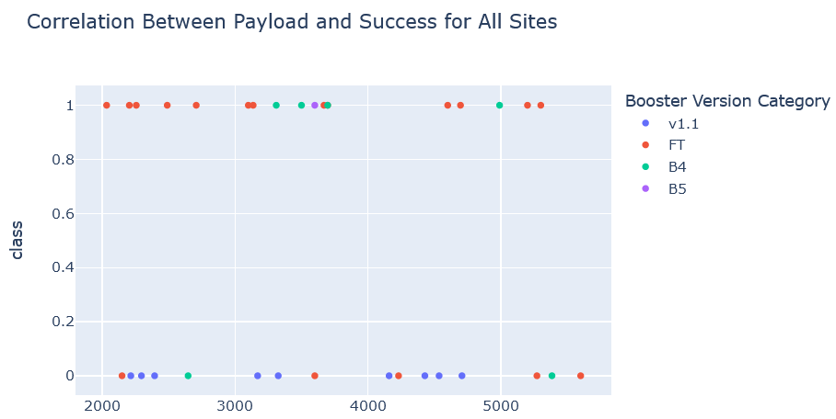
Payload vs launch outcome for all sites
Payload selected: - 0 – 10,000 kg (top) - 2,000 – 5,000 kg (below)
Charts show that payload between 2,000 and 5,000 kg have the highest success rate

Slide 40

Section 5

Slide 41
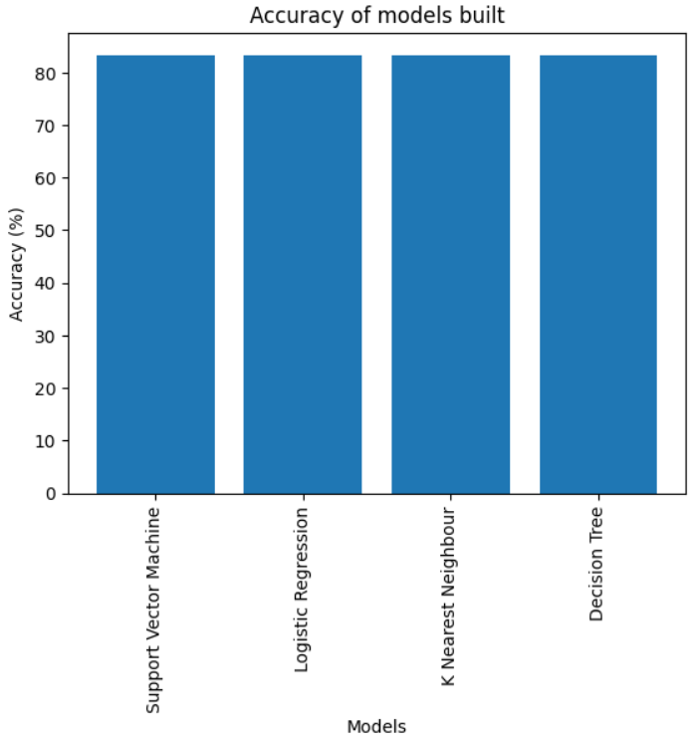
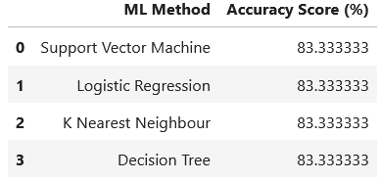
Classification Accuracy
All the models built performed at the same level and had the same accuracy, likely due to the small dataset

Slide 42
Classification Accuracy
However, when looking at the best score, the decision tree slightly outperformed the others:

Slide 43
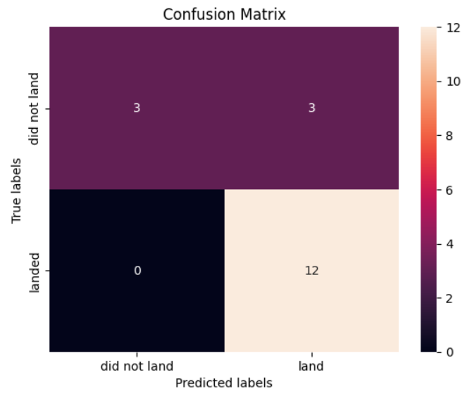
Confusion Matrix
The confusion matrix of the decision tree model showed a very good performance for successful outcome
However, there were three false positives which constitutes a big problem
Overall, the model will overestimate the probability of a positive outcome

Slide 44
Conclusions
All models performed similarly, but the The Decision Tree model was the best fit for this dataset
All the launching sites were near coastlines and as close to the Equator as they could be while being on American territory
Launch with a payload between 2,000 and 5,000 kg are more likely to be successful
The rate of successful launch has been steadily increasing over the years
Orbits ES-L1, GEO, HEO, and SSO had a 100% success rate

Slide 45
Appendix
All codes and results are in the following Jupyter Notebooks:
https://github.com/bncloubiere/IBM_Data_Science_final_project/blob/main/Part01_SPACEX_Data_collection_API.ipynb https://github.com/bncloubiere/IBM_Data_Science_final_project/blob/main/Part02_SPACEX_WEB_scraping.ipynb https://github.com/bncloubiere/IBM_Data_Science_final_project/blob/main/Part03_SPACEX_Data_wrangling.ipynb https://github.com/bncloubiere/IBM_Data_Science_final_project/blob/main/Part04_SPACEX_EDA_sql.ipynb https://github.com/bncloubiere/IBM_Data_Science_final_project/blob/main/Part05_SPACEX_Data_visualisation.ipynb https://github.com/bncloubiere/IBM_Data_Science_final_project/blob/main/Part06_SPACEX_Data_visualisation_folium.ipynb https://github.com/bncloubiere/IBM_Data_Science_final_project/blob/main/Part07_SPACEX_Data_analysis_plotly.py https://github.com/bncloubiere/IBM_Data_Science_final_project/blob/main/Part08_SPACEX_Predictive_analysis.ipynb

Slide 46


